Slide 1
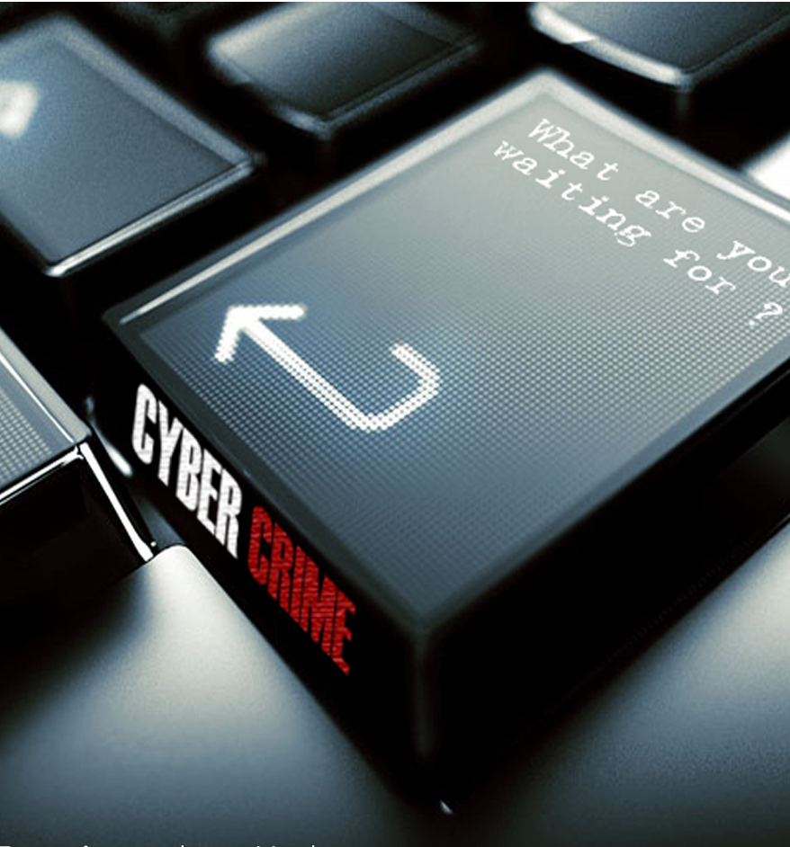
Cyber Security and Laws

Slide 2
Syllabus
Course code: ECCILO 7016
IA I -20 marks
IA II- 20 marks
End exam – 80 marks
Module No | Module Name | No of Hrs
1 | Introduction to Cybercrime | 04
2 | Cyber Offenses & Cybercrime | 09
3 | Tools and Methods Used in Cyberline | 06
4 | The Concept of Cyberspace | 08
5 | Indian IT Act | 06
6 | Information Security Standard compliances | 06

Slide 3
Course outcomes:
After successful completion of the course student will be able to
Understand the concept of cybercrime and its effect on outside world
Interpret and apply IT law in various legal issues
Distinguish different aspects of cyber law
Apply Information Security Standards compliance during software design and development

Slide 4
Reference Books:
Nina Godbole, Sunit Belapure, Cyber Security, Wiley India, New Delhi
The Indian Cyber Law by Suresh T. Vishwanathan; Bharat Law House New Delhi
The Information technology Act, 2000; Bare Act- Professional Book Publishers, New Delhi.
Cyber Law & Cyber Crimes By Advocate Prashant Mali; Snow White Publications, Mumbai
Nina Godbole, Information Systems Security, Wiley India, New Delhi.
Kennetch J. Knapp, Cyber Security &Global Information Assurance Information SciencePublishing.
William Stallings, Cryptography and Network Security, Pearson Publication

Slide 5
Module 1: Learning Objectives
End of this unit, you will be able to:
Learn what cybercrime is and appreciate the importance of cybercrime as a topic.
Understand the different types cybercrime.
Understand the difference between cybercrime and cyber fraud.
Learn about different types of cybercriminals and the motives behind them
Get an overview of cybercrime scenario in India and global
Understand legal perspective on cybercrime.

Slide 6
Unit 2: Learning Objectives
Understand different types of cyberattacks.
Get an overview of the steps involved in planning cybercrime
Understand tools used for gathering information about the target
Get an overview on social engineering
Learn about the role of cybercafe in cybercrime
Understand what is cyberstalking
Learn about botnet and attack vector
Get an overview of cloud computing

Slide 7
Unit 3: Learning Objectives
Understand the security challenges presented by mobile devices and information systems access in the cybercrime world.
Understand challenges faced by the mobile workforce and implication under the cybercrime era.
Mitigation strategy – credit card users.
Security issues due to use of media players

Slide 8
Unit 4: Learning Objectives
Proxy servers and anonymizers
Password cracking
Keyloggers and spywares
Overview of virus and worms
Trojan horses and backdoors
Steganography
DoS attacks
SQL injection

Slide 9
Unit 5: Learning Objectives
Phishing and its techniques
Identity theft

Slide 10
Unit 6: Learning Objectives
Cyber laws
Legal perspectives

Slide 11
1.1 INTRODUCTION
The internet in India is growing rapidly. It has given rise to new opportunities in every field we can think of be it entertainment, business, sports or education.
There’re two sides to a coin. Internet also has it’s own disadvantages is Cyber crime- illegal activity committed on the internet.

Slide 12
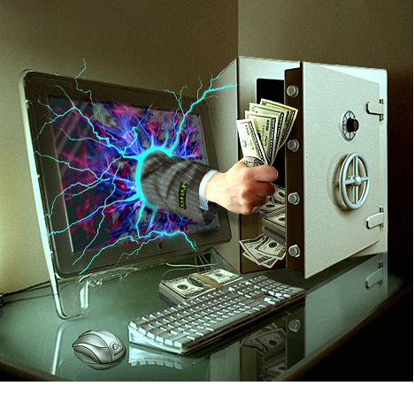
1.2 DEFINING CYBER CRIME
Crime committed using a computer and the internet to steal data or information.
Illegal imports.
Malicious programs.

Slide 13

Cybercrime
Cybercrime is not a new phenomena
The first recorded cybercrime took place in the year 1820.
In 1820, Joseph Marie Jacquard, a textile manufacturer in France, produced the loom. This device allowed the repetition of a series of steps in the weaving of special fabrics. This resulted in a fear amongst Jacquard's employees that their traditional employment and livelihood were being threatened. They committed acts of sabotage (deliberately destroy) to discourage Jacquard from further use of the new technology. This is the first recorded cyber crime!

Slide 14
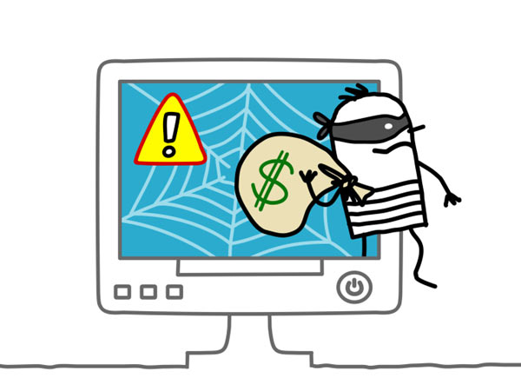
Alternative definitions for cybercrime
Any illegal act where a special knowledge of computer technology is essential for its perpetration, investigation.
Any financial dishonesty that takes place in a computer environment.
Any threats to the computer itself, such as theft of hardware or software, sabotage(destractive, deliberately destroy) .

Slide 15
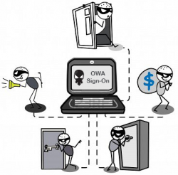
Another definition
“Cybercrime (computer crime) is any illegal behavior, directed by means of electronic operations, that target the security of computer systems and the data processed by them”.
Hence cybercrime can sometimes be called as computer-related crime, computer crime, E-crime, Internet crime, High-tech crime….

Slide 16
Cybercrime specifically can be defined in number of ways…
A crime committed using a computer and the internet to steal a person’s identity(identity theft) or sell contraband or stalk victims or disrupt operations with malevolent programs.
Crimes completed either on or with a computer
Any illegal activity through the Internet or on the computer.
All criminal activities done using the medium of computers, the Internet, cyberspace and the WWW.

Slide 17
further
Cybercrime refers to the act of performing a criminal act using cyberspace as communication vehicle.
Two types of attacks are common:
Techno- crime : Active attack
Techno Crime is the term used by law enforcement agencies to denote criminal activity which uses (computer) technology, not as a tool to commit the crime, but as the subject of the crime itself. Techno Crime is usually pre-meditated and results in the deletion, corruption, alteration, theft or copying of data on an organization's systems.
Techno – vandalism: Passive attack
Techno Vandalism is a term used to describe a hacker or cracker who breaks into a computer system with the sole intent of defacing and or destroying its contents.
Techno Vandals can deploy 'sniffers' on the Internet to locate soft (insecure) targets and then execute a range of commands using a variety of protocols .
The best weapon against such attacks is a firewall which will hide and disguise your organization's presence on the Internet.

Slide 18
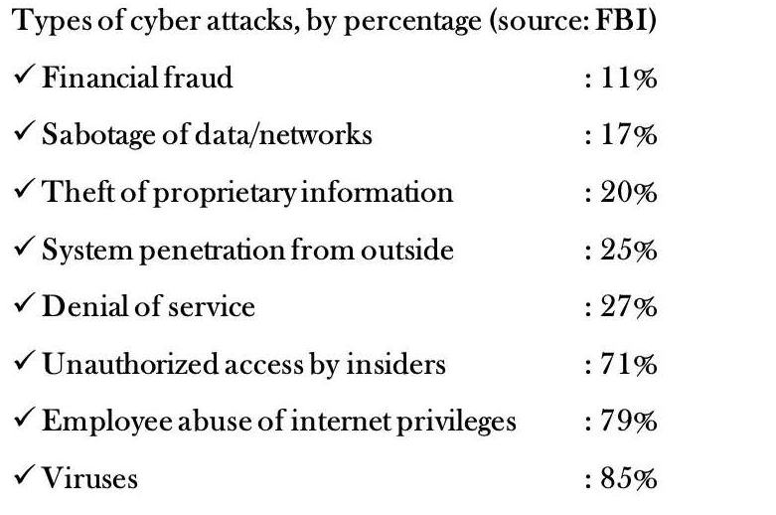
Cyber Attack by percentage

Slide 19
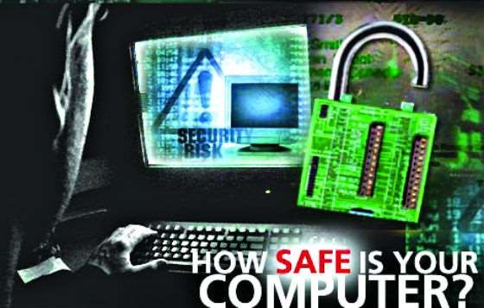
Why Should we know about Cyber Crime?
In this Tech-savvy world of 21st Century every one is engaged with internet, through whatsapp, twitter, facebook, net banking & lots of other platforms are there.
And some criminal minded persons commit crimes here, which is included under cybercrime.
So we should be aware about crimes happening around in the cyber-space.

Slide 20
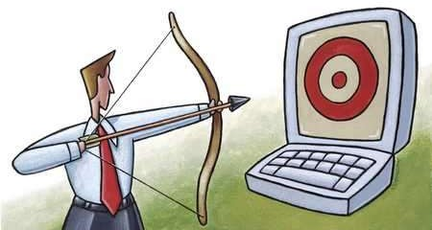
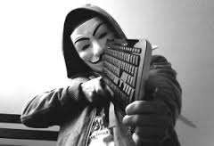
Cyber Criminals use
The Computer as a Target : using a computer to attack other computers. E.g Hacking, virus/worm attacks, Dos attacks etc.
The computer as a weapon : using a computer to commit real world crimes. E.g Cyber terrorism, credit card frauds, Child pornography etc.

Slide 21

1.3 Cybercrime and information security
Lack of information security give rise to cybercrime
Cyber security: means protecting information, equipment, devices, computer, computer resource, communication device and information stored therein from unauthorized access, use, disclosure, modification or destruction.

Slide 22
What Is the CIA Triad and Why Is It Important for Information security?
Cyber and Information security is aimed at protecting the company’s digital assets against the ever-growing cyber-attacks.
Cyber and Information security can be ensured by deploying appropriate security controls to provide several security features such as prevention and detection of cybercrimes.
The main purpose of Cyber and Information security is to ensure Confidentiality, Integrity, and Availability (CIA) of data and services.

Slide 23
Confidentiality :
Ensures privacy to the sensitive information while it is in transit over a network.
Protection from disclosure to unauthorized persons. Thus only intended recipients can see data or information.
There are various implementations which can be incorporated to ensure the confidentiality of data.
Cryptography
Cipher text
Strong passwords and Two-way authentication

Slide 24
Integrity:
Preventing data from being tampered with, modified, or altered in an unauthorized way to achieve malicious goals.
Trustworthiness of data or resources in terms of preventing improper and unauthorized changes.
Availability:
Security service which ensures the constant availability of resources and services to only authorized parties in a timely manner.
Ability to use information or desired resources.
Quick disaster recovery plans should be followed in worst case scenarios. One of security controls for availability is data backup.

Slide 25
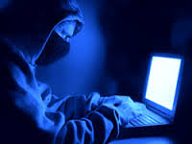
1.4 Who are Cybercriminals?
Are those who conduct acts such as:
Credit card fraud
Cyber stalking
Defaming another online
Gaining unauthorized access to computer systems
Ignoring copyrights
Software licensing and trademark protection
Overriding encryption to make illegal copies
Software piracy
Stealing another’s identity to perform criminal acts
Child pornography

Slide 26
Categorization of Cybercriminals
Type 1: Cybercriminals- hungry for recognition
Hobby hackers
A person who enjoys exploring the limits of what is possible, in a spirit of playful cleverness. May modify hardware/ software
Politically motivated hackers :
promotes the objectives of individuals, groups or nations supporting a variety of causes such as : Anti globalization, conflicts and protest
Terrorist organizations
Cyber terrorism
Use the internet attacks in terrorist activity
Large scale disruption of computer networks , personal computers attached to internet via viruses

Slide 27
Type 2: Cybercriminals- not interested in recognition
Financially motivated hackers
Make money from cyber attacks
Bots-for-hire : fraud through information theft, spam and extortion
State-sponsored hacking
Extremely professional groups working for governments
Have ability to worm into the networks of the media, major corporations, defense departments

Slide 28
Type 3: Cybercriminals- the insiders
Disgruntled or former employees seeking revenge
Competing companies using employees to gain economic advantage through damage and/ or theft.

Slide 29
Again we can categorized into :
Cyber Piracy: Using cyber technology in unauthorized way to reproduce copies of proprietary software and information or to distribute the same across computer network.
Cyber trespass: Using cyber technology to gain unauthorized access to an individual’s or organization's computer system or password protected websites.
Cyber Vandalism: Using cyber technology to release one or more programs that disturbs the transmission of electronic information across one or more computer network.

Slide 30
Motives behind cybercrime
Greed
Desire to gain power
Publicity
Desire for revenge
A sense of adventure
Looking for thrill to access forbidden information
Destructive mindset
Desire to sell network security services

Slide 31
1.5 Classification of cybercrimes
Cybercrime against an individual
Cybercrime against property
Cybercrime against organization
Cybercrime against Society
Crimes originate from from Usenet newsgroup

Slide 32
1. Cybercrime against an individual
Electronic mail spoofing and other online frauds
Spamming
Cyber defamation
Cyber stalking and harassment
Computer sabotage
Pornographic offenses
Password sniffing

Slide 33
2.Cybercrime against property
Credit card frauds
Intellectual property( IP) crimes
Internet time theft

Slide 34
3.Cybercrime against organization
Unauthorized accessing of computer
Password sniffing
Denial-of-service attacks
Virus attack/dissemination of viruses
E-Mail bombing/mail bombs
Salami attack/ Salami technique
Trojan Horse
Data diddling
Industrial spying/ industrial espionage
Computer network intrusions
Software piracy

Slide 35
4.Cybercrime against Society
Forgery
Cyber terrorism
Web jacking

Slide 36
History of Usenet groups
In 1979 it was developed by two graduate students from Duke University in North Carolina (UNC) as a network that allowed users to exchange quantities of information too large for mailboxes
Usenet was designed to facilitate textual exchanges between scholars.
Slowly, the network structure adapted to allow the exchange of larger files such as videos or images.

Slide 37
5.Crimes emanating from Usenet newsgroup
Usenet groups may carry very offensive, harmful, inaccurate material
Postings that have been mislabeled or are deceptive in another way
Hence service at your own risk

Slide 38
1. Cybercrime against an individual
Electronic mail spoofing and other online frauds
Spamming
Cyber defamation
Cyber stalking and harassment
Computer sabotage
Pornographic offenses
Password sniffing

Slide 39
E-Mail Spoofing
E-mail spoofing is the forgery of an e-mail header so that the message appears to have originated from someone or somewhere other than the actual source.
Thus, someone could send spoofed e-mail that appears to be from you with a message that you didn't write.

Slide 40
E-Mail Spoofing
Although most spoofed e-mail falls into the "nuisance" category and requires little action other than deletion, the more malicious varieties can cause serious problems and security risks.
For example, spoofed e-mail may purport to be from someone in a position of authority, asking for sensitive data, such as passwords, credit card numbers, or other personal information -- any of which can be used for a variety of criminal purposes.
The Bank of America, eBay, and Wells Fargo are among the companies recently spoofed in mass spam mailings.
One type of e-mail spoofing, self-sending spam, involves messages that appear to be both to and from the recipient.

Slide 41
Spamming
People who create electronic spam : spammers
Spam is abuse of electronic messaging systems to send bulk messages indiscriminately
Spamming may be
E-Mail Spam
Instant messaging spam
Usenet group spam
Web search engine spam
Spam in blogs, wiki spam
Online classified ads spam
Mobile phone messaging spam
Internet forum spam
Junk fax spam
Social networking spam
……..

Slide 42
Cyber defamation
The tort of cyber defamation is considered to be the act of defaming, insulting, offending or otherwise causing harm through false statements pertaining to an individual in cyberspace.
Example: someone publishes defamatory matter about
someone on a website or sends an E-mail containing defamatory information to all friends of that person.

Slide 43
It may amount to defamation when-
If imputation to a deceased person would harm the reputation of that person, and is intended to be hurtful to the feelings of his family or other near relatives
An imputation is made concerning a company or an association or collection of people as such.
An imputation in the form of an alternative or expressed ironically
An imputation that directly or indirectly, in the estimation of others, lowers the moral or intellectual character of that person, or lowers the character of that person in respect of his caste or of his calling, or lowers the credit of that person.

Slide 44
Types of defamation
Libel : written defamation
Slander: oral defamation
When failed to prove, the person who made the allegations may still be held responsible for defamation.

Slide 45
Cyber defamation cases
In first case of cyber defamation in India (14 dec 2009),
the employee of a corporate defamed its reputation was sending derogatory and defamatory emails against the company and its managing director
In this case the Court(delhi court) had restrained the defendant from sending derogatory, defamatory, obscene, vulgar, humiliating and abusive emails.
The court passed as important ex-parte injunction.
In another case, accused posted obscene, defamatory and annoying message about a divorcee woman and also sent emails to the victim.
The offender was traced and was held guilty of offences under section 469, 509 IPC and 67 of IT Act, 2000.
Other defamation cases:
A malicious customer review by a competitor could destroy a small business.
A false accusation of adultery on a social networking site could destroy a marriage.
An allegation that someone is a “crook” could be read by a potential employer or business partner

Slide 46

Computer sabotage
Computer sabotage involves deliberate attacks intended to disable computers or networks for the purpose of disrupting commerce, education and recreation for personal gain, committing espionage, or facilitating criminal conspiracy.
Through viruses, worms, logic bombs
Chernobyl virus
The Chernobyl virus is a computer virus with a potentially devastating payload that destroys all computer data when an infected file is executed.,
Y2K virus
Y2K bug, also called Year 2000 bug or Millennium Bug, a problem in the coding of computerized systems that was projected to create havoc in computers and computer networks around the world at the beginning of the year 2000

Slide 47
Pornographic offenses: Child pornography
Means any visual depiction, including but not limited to the following:
Any photograph that can be considered obscene and/ or unsuitable for the age of child viewer.
Film ,video, picture;
Obscene Computer generated image or picture

Slide 48
How do they Operate
Pedophiles use false identity to trap the children/teenagers
Pedophiles contact children/teens in various chat rooms which are used by children/teen to interact with other children/teen.
Befriend the child/teen.
Extract personal information from the child/teen by winning his confidence.
Gets the e-mail address of the child/teen and starts making contacts on the victims e-mail address as well.
Starts sending pornographic images/text to the victim including child pornographic images in order to help child/teen shed his inhibitions so that a feeling is created in the mind of the victim that what is being fed to him is normal and that everybody does it.
Extract personal information from child/teen
At the end of it, the pedophile set up a meeting with the child/teen out of the house and then drag him into the net to further sexually assault him or to use him as a sex object.

Slide 49
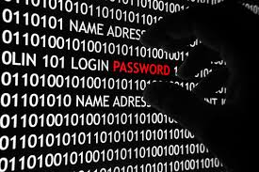
Password sniffing
Password sniffers are programs that monitor and record the name and password of network users as they login at a site.
through sniffers installed, anyone can impersonate an authorized user and login to access restricted documents.

Slide 50
2.Cybercrime against property
Credit card frauds
Intellectual property( IP) crimes
Internet time theft

Slide 51
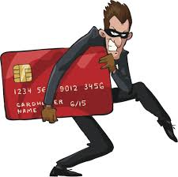
Credit card frauds
Credit card fraud is a wide-ranging term for theft and fraud committed using or involving a payment card, such as a credit card or debit card, as a fraudulent source of funds in a transaction.
The purpose may be to obtain goods without paying, or to obtain unauthorized funds from an account.
Credit card fraud is also an adjunct to identity theft.

Slide 52
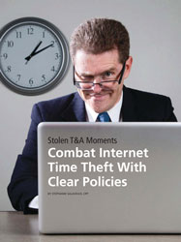
Internet Time Theft
Occurs when an unauthorized person uses
the Internet hours paid for by another person
Comes under hacking
The person get access to someone else’s user ID and password, either by hacking or by gaining access to it by illegal means
And uses the internet without the other person’s knowledge
This theft can be identified when Internet time is recharged often, despite infrequent usage.
This comes under “identity theft”

Slide 53
3.Cybercrime against organization
Unauthorized accessing of computer
Password sniffing
Denial-of-service attacks
Virus attack/dissemination of viruses
E-Mail bombing/mail bombs
Salami attack/ Salami technique
Trojan Horse
Data diddling
Industrial spying
Computer network intrusions
Software piracy

Slide 54
Password sniffing
Password sniffers are programs that monitor and record the name and password of network users as they login at a site.
through sniffers installed, anyone can impersonate an authorized user and login to access restricted documents.

Slide 55
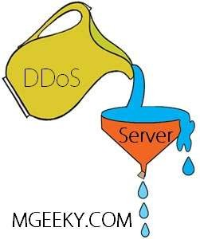
Denial of Service(DOS)
Act by the criminal, who floods the bandwidth of the victims network or Internet server is flooded with continuous requests so as to crash the server
Its an attempt to make a machine or network resource unavailable to its intended users

Slide 56

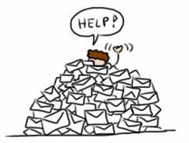
E-mail bombing/mail bombs
In Internet usage, an email bomb is a form of net abuse consisting of sending huge volumes of email to an address in an attempt to overflow the mailbox or overwhelm the server where the email address is hosted in a denial-of-service attack.
Construct a computer to repeatedly send E-mail to a specified person’s E-mail address.

Slide 57
Salami attack/ salami technique
Are used for committing financial crimes.
The alterations made are so insignificant that in a single case it would go completely unnoticed.
Example: a bank employee inserts a program, into the bank’s serve, that deduces a small amount from the account of every customer every month,
The unauthorised debit goes unnoticed by the customers, but the employee will make a sizable amount every month.
One more example is The petrol pump fraud

Slide 58
Website Hacking:
Website Hacking means taking control from the website owner to a person who hacks the website.
Nowadays most of the government websites are attacked by hackers. Many governmental websites including the president’s website were hacked.

Slide 59
Computer Vandalism
Damaging or destroying data rather than stealing.
Transmitting virus to destroy system files.
Ransomware
Ransomware is malicious software that infects your computer and displays messages demanding a fee to be paid in order for your system to work again. This class of malware is a criminal moneymaking scheme that can be installed through deceptive links in an email message, instant message or website

Slide 60
Spamming
Spamming is difficult to control
Advertisers have no operating costs beyond the management of their mailing lists
It is difficult to hold senders accountable for their mass mailings
Spammers are numerous

Slide 61
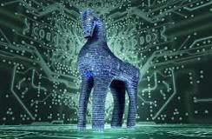
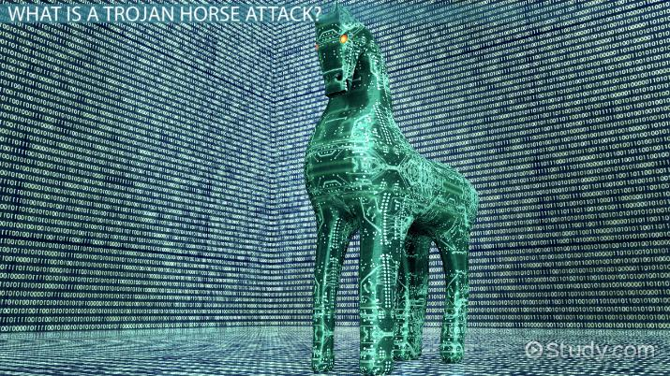
Trojan Horse
A Trojan Horse Virus is a type of malware that downloads onto a computer disguised as a legitimate program.
The delivery method typically sees an attacker use social engineering to hide malicious code within legitimate software to try and gain users' system access with their software.

Slide 62
Data diddling
Data diddling involves changing data input in a computer.
In other words, information is changed from the way it should be entered by a person typing in the data.
Usually, a virus that changes data or a programmer of the database or application has pre-programmed it to be changed.
For example, a person entering accounting may change data to show their account, or that or a friend or family member, is paid in full. By changing or failing to enter the information, they are able to steal from the company.

Slide 63
To deal with this type of crime, a company must implement policies and internal controls.
This may include performing regular audits, using software with built-in features to combat such problems, and supervising employees.

Slide 64
Industrial spying/ Industrial Espionage
Industrial espionage is the covert and sometimes illegal practice of investigating competitors to gain a business advantage.
The target of investigation might be a trade secret such as a proprietary product specification or formula, or information about business plans.
In many cases, industrial spies are simply seeking any data that their organization can exploit to its advantage.

Slide 65
Real life case
A Chinese Trojan horse email campaign targeted some 140 senior Israeli defense corporation employees (2013) involved in highly classified, sensitive security projects.
The email was made to appear as if it came from a known German company that regularly works with the Israeli defense industry.
However, it turned out to contain a Trojan horse, which, according to the report, attempted to funnel information from the recipients' computers.
The Trojan horse was noticed by computer defense systems and shut down.
The defense establishment then realized how many Israelis received the email, and reportedly tracked the malicious program down to Chinese defense industries.
The incident led security companies to reiterate to employees computer security guidelines.

Slide 66

Computer network intrusions
An intrusion to computer network from any where in the world and steal data, plant viruses, create backdoors, insert trojan horse or change passwords and user names.
An intrusion detection system (IDS) inspects all inbound and outbound network activity and identifies suspicious patterns that may indicate a network or system attack from someone attempting to break into or compromise a system.
The practice of strong password

Slide 67

Software piracy
Theft of software through the illegal copying of genuine programs or the counterfeiting and distribution of products intended to pass for the original.
End-user copying
Hard disk loading with illicit means
Counterfeiting
Illegal downloads from internet

Slide 68
Buying Pirated software have a lot to lose:
Getting untested software that may have been copied thousands of times.
Potentially contain hard-ware infecting viruses
No technical support in case of software failure
No warranty protection
No legal right to use the product

Slide 69
4.Cybercrime against Society
Forgery
Cyber terrorism
Web jacking

Slide 70
Forgery
The act of forging something, especially the unlawful act of counterfeiting a document or object for the purposes of fraud or deception.
Something that has been forged, especially a document that has been copied or remade to look like the original.
Counterfeit currency notes, postage, revenue stamps, marksheets, etc., can be forged using sophisticated computers, printers and scanners.

Slide 71
Real life case:
Stamp Paper Scam – a racket that flourished on loopholes in the system
Telgi, the mastermind of the multi-crore counterfeiting, printed fake stamp papers worth thousands of crores of rupees using printing machines purchased illegally with the help of some conniving officials of the Central Govt.’s Security Printing Press (India Security Press) located in Nasik. These fake stamp papers penetrated in more than 12 states through a widespread network of vendors who sold the counterfeits without any fear and earned hefty commissions.
counterfeit: to imitate something authentic, with the intent to steal, destroy, or replace the original, for use in illegal transactions, or otherwise to deceive individuals into believing that the fake is of equal or greater value than the real thing.
Amount swindled Rs. 172 crores

Slide 72

Web jacking
This term is derived from the term hi jacking.
In these kinds of offences the hacker gains access and control over the web site of another.
He may even change the information on the site.
The first stage of this crime involves “password sniffing”.
The actual owner of the website does not have any more control over what appears on that website
This may be done for fulfilling political objectives or for money

Slide 73
Real life examples
Recently the site of MIT (Ministry of Information Technology) was hacked by the Pakistani hackers and some obscene matter was placed therein.
Further the site of Bombay crime branch was also web jacked.

Slide 74
Hacking
Hacking in simple terms means an illegal intrusion or unauthorized access to or control over a computer system and/or network.
Purpose
Greed
Power
Publicity
Revenge
Adventure
Desire to access forbidden information
Destructive mindset

Slide 75
Hacking vs. Cracking
Malicious attacks on computer networks are officially known as cracking ,
while hacking truly applies only to activities having good intentions.
Most non-technical people fail to make this distinction, however.
Outside of academia, its extremely common to see the term "hack" misused and be applied to cracks as well.

Slide 76
There are 3 types of modern hackers
Black Hats: Criminal Hackers.
Possess desire to destruction
Hack for personal monetary gains : Stealing credit card information, transferring money from various bank accounts to their own account, extort money from corporate giant by threatening.
White Hats: Ethical Hackers.
Network Security Specialist.
Grey Hats: Deals in both of the above (jack of all trades, master of none).

Slide 77
Real life Case: Dec 2009 NASA site hacked via SQL Injection
Two NASA sites recently were hacked by an individual wanting to demonstrate that the sites are susceptible to SQL injection.
The websites for NASA's Instrument Systems and Technology Division and Software Engineering Division were accessed by a researcher, who posted to his blog screen shots taken during the hack.
The researcher, using the alias "c0de.breaker," used SQL injection to hijack the sites.
SQL injection is an attack process where a hacker adds additional SQL code commands to a page request and the web server then tries to execute those commands within the backend database
The NASA hack yielded the credentials of some 25 administrator accounts.
The researcher also gained access to a web portal used for managing and editing those websites.
In this particular case, the researcher found the vulnerabilities, made NASA aware of them, then published findings after the websites had been fixed.
An attacker, however, could have tried to use that web server as an entry point into other systems NASA might control or edit the content of the sites and use them for drive-by downloads.

Slide 78
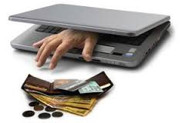
Online frauds
Fraud that is committed using the internet is “online fraud.” Online fraud can involve financial fraud and identity theft.
Online fraud comes in many forms.
viruses that attack computers with the goal of retrieving personal information, to email schemes that lure victims into wiring money to fraudulent sources,
“phishing” emails that purport to be from official entities (such as banks or the Internal Revenue Service) that solicit personal information from victims to be used to commit identity theft,
to fraud on online auction sites (such as Ebay) where perpetrators sell fictional goods.
E-Mail spoofing to make the user to enter the personal information : financial fraud
Illegal intrusion: log-in to a computer illegally by having previously obtained actual password. Creates a new identity fooling the computer that the hacker is the genuine operator. Hacker commits innumerable number of frauds.

Slide 79
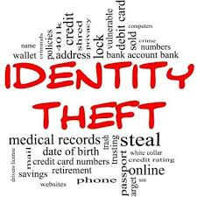
Identity theft
Identity theft is a fraud involving another person’s identity for an illicit purpose.
The criminal uses someone else’s identity for his/ her own illegal purposes.
Phishing and identity theft are related offenses
Examples:
Fraudulently obtaining credit
Stealing money from victim’s bank account
Using victim’s credit card number
Establishing accounts with utility companies
Renting an apartment
Filing bankruptcy using the victim’s name

Slide 80
Real life cases
Dr. Gerald Barnes Gerald Barnbaum lost his pharmacist license after committing Medicaid fraud. He stole the identity of Dr. Gerald Barnes and practiced medicine under his name. A type 1 diabetic died under his care. “Dr. Barnes” even worked as a staff physician for a center that gave exams to FBI agents. He’s currently serving hard time.
Andrea Harris-Frazier Margot Somerville lost her wallet on a trolley. Two years later she was arrested. Andrea Harris-Frazier had defrauded several banks—using Somerville’s identity—out of tens of thousands of dollars. The real crook was caught.
Abraham Abdallah A busboy named Abraham Abdallah got into the bank accounts of Steven Spielberg and other famous people after tricking his victims via computer, getting sufficient data to fake being their financial advisors—then calling their banks…and you know the rest.

Slide 81

How to tackle these
Awareness is the first step in protecting yourself, your family and your business.
Invest in Anti-virus, Firewall, and SPAM blocking software for your PC.
Detect secure websites when conducting transactions online.
Do NOT respond or act on emails sent from unknown sources.

Slide 82

Safety Tips to Cyber Crime
Use antivirus software & insert firewalls
Read Privacy policy carefully when you submit the data through internet.
Uninstall unnecessary software
Maintain backup
Check security settings
Disable Remote Connectivity
Use hard-to-guess passwords. Don’t use words found in a dictionary. Remember that password cracking tools exist.
Never give your full name or address to strangers
Learn more about Internet privacy

Slide 83
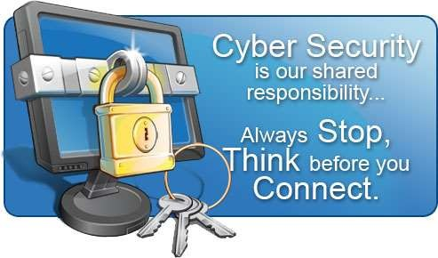
Cyber Security
Internet security is a branch of computer security specifically related to the Internet.
It's objective is to establish rules and measure to use against attacks over the Internet.

Slide 84

Cyber Security Advantages
The cyber security will defend us from critical attacks, hacks and virus.
It helps us to browse the safe website.
Internet security process all the incoming and outgoing data on our computer.
The application of cyber security used in our PC needs update every week.
The security developers will update their database every week once. Hence the new virus also deleted

Slide 85
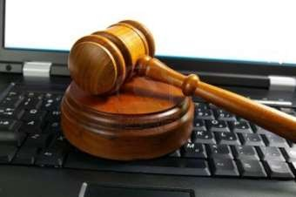
Cyber Law
There is absolutely no comprehensive law on Cybercrime any where in the world. This is reason that the investigating agencies like FBI are finding the Cyberspace to be an extremely difficult terrain.
Cybercrimes fall into that grey area of Internet law which is neither fully nor partially covered by the existing laws.
However, countries are taking crucial measures to establish stringent laws on cybercrime.
In Nepal,
Electronic Transaction act 2061 BS (2005 AD)
Information Technology Policy - 2000

Slide 86
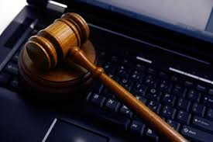
Cybercrime: the legal perspective
Cybercrime possess a mammoth challenge
Computer crime: Criminal Justice Resource Manual(1979)
Any illegal act for which knowledge of computer technology is essential for a successful prosecution.
International legal aspects of computer crimes were studied in 1983
Encompasses any illegal act for which the knowledge of computer technology is essential for its perpetration

Slide 87
Cybercrime: the legal perspective
The network context of cyber crime make it one of the most globalized offenses of the present and most modernized threats of the future.
Solution:
Divide information system into segments bordered by state boundaries.
Not possible and unrealistic because of globalization
Or incorporate the legal system into an integrated entity obliterating these state boundaries.

Slide 88
Cybercrimes: An Indian Perspective
India has the fourth highest number of internet users in the world.
45 million internet users in India
37% - in cybercafes
57% are between 18 and 35 years
The Information Technology (IT) Act, 2000, specifies the acts which are punishable. Since the primary objective of this Act is to create an enabling environment for commercial use of I.T.

Slide 89
Incidence of Cyber Crimes in Cities
17 out of 35 mega cities did not report any case of Cyber Crime i.e, neither under the IT Act nor under IPC Sections) during the year 2007.
17 mega cities have reported 118 cases under IT Act and 7 megacities reported 180 cases undervarious section of IPC.
There was an increase of 32.6% (from 89 cases in 2006 to 118 cases in 2007) in cases under IT Act as compared to previous year (2006),
and an increase of 26.8% (from 142 cases in 2006 to 180 cases in 2007) of cases registered under various section of IPC
Bengaluru (40), Pune (14) and Delhi (10) cities have reported high incidence of cases (64 out of 118 cases) registered under IT Act, accounting for more than half of the cases (54.2%) reported under the Act.

Slide 90
Provisions of Cyber Crimes in the IT Act, 2000 The sections of the IT Act, 2000 pertaining to cybercrimes are as follows:
Section 43 – Penalty for damage to a computer, computer system, etc.
This section applies if any person, without the permission of the owner or the person in charge of a computer, system, or network –
Accesses such computer, network or system.
Copies, downloads or extracts any data or information from such computer, network or system (this also includes the information or data stored in a removable storage medium).
Also, introduces or causes any computer containment or virus into such computer, network or system.

Slide 91
Further, he damages any computer, system or data or any other programs residing in them.
Disrupts or causes disruption of any such computer, system or network.
Also, denies or causes the denial of access to an authorized person to such computer, system or network.
Provides any assistance to anyone to facilitate access to such a computer, system or network contrary to the provisions of the Act and its rules.
Also, charges the services availed of by one person to the account of another by tampering with such computer, system or network.
Penalty – Compensation, not exceeding one crore rupees to the affected person.

Slide 92
Section 65 – Tampering with the computer’s source code documents
This section applies to a person who intentionally conceals, alters or destroys any computer source code used for a computer, program, system or network when the law requires the owner to keep or maintain the source code. It also applies to a person who intentionally causes another person to do the same.
Penalty – Imprisonment of up to three years or a fine of up to two lakh rupees, also both in some cases.

Slide 93
Section 66 – Hacking of a Computer System
This section applies to a person who commits hacking. Hacking is when the person intentionally or knowingly causes a wrongful loss or damage to the public or another person or destroys or deletes any information residing in a computer resource or diminishes its utility or value or injures it by any means.
Penalty – Imprisonment of up to three years or a fine of up to two lakh rupees, also both in some cases.

Slide 94
Section 67 – Publishing obscene information in an electronic form
This section applies to a person who publishes or transmits any obscene material – material which is lascivious or appeals to the prurient interests or tends to deprave or corrupt persons who are likely to read, see or hear the matter embodied in it. It also applies to a person who causes the publishing or transmission of such material.
Penalty – In case of the first conviction, imprisonment of up to five years and a fine of up to one lakh rupees. For subsequent convictions, imprisonment of up to 10 years and a fine of up to two lakh rupees.

Slide 95
Section 74 – Publication with the intention of fraud
This section applies to a person who knowingly creates, publishes or makes available a digital certificate with the intention of fraud.
Penalty – Imprisonment of up to two years or a fine of up to one lakh rupees, also both in some cases.

